Slide 1

Identity Security Cloud
IAM Delivery & IAM Operations

Slide 2
Table of Content
IdentityIQ vs IdentityNow
Getting started with IdentityNow
Rules/Transforms
Event Triggers
Workflows
Rest API
Source Creation
Access Reviews
Access Requests
ServiceNow Integration
Okta Integration
SaaS Connectivity
Email Templates
Miscellaneous

Slide 3
Differences Between SailPoint IdentityIQ (IIQ) and SailPoint IdentityNow
Deployed within an organization's data center or private cloud infrastructure
complex and time-consuming, need to set up and configure on-premises infrastructure.
traditional software licensing model, where organizations pay for software licenses and maintenance fees
It's hosted and managed by SailPoint in the cloud
typically, quicker to implement since it is a cloud-based solution
subscription-based pricing model, where organizations pay a recurring fee based on the number of users or other factors.

Slide 4
Differences Between SailPoint IdentityIQ (IIQ) and SailPoint IdentityNow
Additional hardware and infrastructure investments as the organization grows. It may be better suited for larger enterprises
Organizations are responsible for managing and maintaining the IIQ infrastructure, including applying updates and patches
designed for scalability in the cloud. It can easily accommodate growth by adding more user licenses without the need for significant infrastructure changes.
SailPoint manages the infrastructure and updates for IdentityNow, reducing the burden on the organization. Updates and new features

Slide 5
Differences Between SailPoint IdentityIQ (IIQ) and SailPoint IdentityNow
IIQ is often preferred by organizations that require extensive customization and have complex identity governance needs.
IdentityIIQ is most appropriate for companies with a strong requirement for customization and for index requests in “role” and “entitlement” based configurations.
It is well-suited for mid-sized businesses and those transitioning to the cloud
giving users simple, intuitive ways to manage their day-to-day needs, from accessing cloud and internal web apps, requesting and reviewing access or resetting password

Slide 6
Getting started with IdentityNow
IdentityNow is our SaaS-based identity governance platform that provides identity services including provisioning, access requests, password management, access certification and separation-of-duties.
With our patented AI & ML capabilities including Access Insights, Access Modeling and Recommendation Engine, as well as our Cloud Governance solutions enhance and accelerate identity related decisions and tasks.
IdentityNow is a leader in the market for a perfect IAM solution for organizations taking the next step into cloud computing.
© Hitachi Vantara LLC 2022. All Rights Res
erved.

Slide 7
Getting started with IdentityNow
Make more informed access decisions with AI-based recommendations
Turn large amounts of identity data into actionable insights
Build roles with the right access automatically
Discover and protect all your cloud platforms and workloads
Intuitive User interface (UI)
It’s extremely scalable and proactive with patches
Having visibility all identities in one place & into applications user’s allows you to make the right security decisions, govern across the whole enterprise
deploy faster leverage the cloud to deploy enterprise identity and access management within days
© Hitachi Vantara LLC 2022. All Rights Res
erved.

Slide 8
Make Add Initial Administrators (Emergency access administrators to make changes and troubleshoot your site.
Loading Data: Sources, link sources to form identity
Creating Identities: HR systems, Authoritative sources,
Identity Profiles: Creating an identity profile turns a source into an authoritative source.
Load Initial accounts : Aggregation
Correlation
Entitlement loading
Security Settings : Strong authentication, Network & location settings, Lockout and Session lengths
© Hitachi Vantara LLC 2022. All Rights Res
erved.

Slide 9
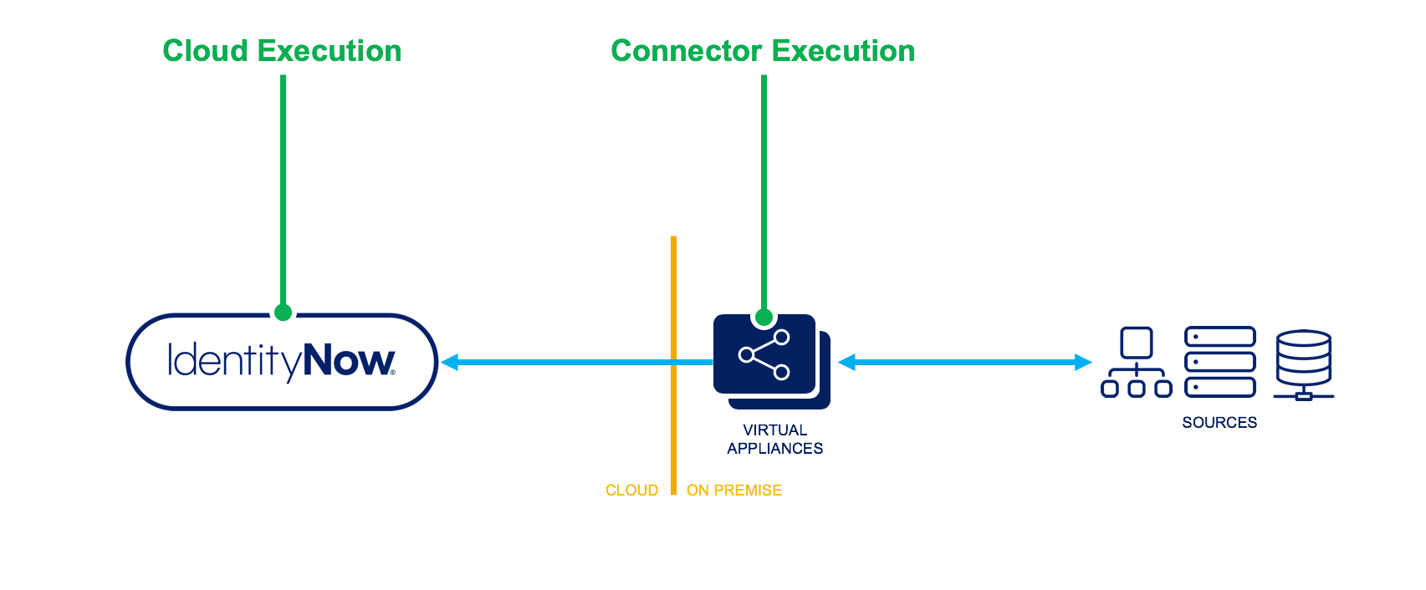
Rules
Rule: serve as a flexible configuration framework implementers can leverage to preform complex or advanced configurations.
Java Beanshell Documentation.
SailPoint has a 24-hour SLA on rule deployments
use log.debug(), log.info(), log.warn(), or log.error() statements.
Promote rules from sandbox to Prod
Certification Exclusion, Identity Selector etc. are depreciated
Cloud Executed Rules | SailPoint Developer Communityonnector Executed Rules | SailPoint Developer Community

Slide 10
Rules
Cloud Execution:
Connector Execution:
runs on multi-tenant cloud
peer review or caution required usually field Value rule.
read-only access identityModel
e.g., Identity/Account Attribute
Generating samAccountName/unique mail
if manager in inactive then it defaults to test manager
Provisioning Rules
Correlation rules
Generic rules
customer writes rule --> SP reviews it --> If approved --> the rule is implemented in identityNow tenant.
Runs on VAs hosted by customer datacenter
can be configured/uploaded by rest APIs
Crucial connector related can be written
No Access identityNow model
usage: Altering data during aggregation generic connector
NO Review
Customer can write rule adhering to identityNow standards
editable via REST APIs
e.g., Before/After Create/Modify Rule
Buildmap/SAP build map rules
Webservices before/after
Disabling user based on the no of entitlemts/leaver status/revocation.
/beta/connector-rule/{id}
.

Slide 11
Transforms
Transforms allow you to manipulate attribute values while aggregating from or provisioning to a source.
A function that takes input and gives output
Transforms are configurable objects that define easy ways to manipulate attribute data without requiring you to write code
Transforms are JSON-based configurations, editable with ISC
Identity Security Cloud's Transform REST APIs.
{ "name": "Lowercase Department", "type": "lower", "attributes": { "transform-attribute-1": "attribute-1-value", "transform-attribute-2": "attribute-2-value" } } | { "type": "static", "attributes": { "value": "$identity.getLinks()" } }
© Hitachi Vantara LLC 2022. All Rights Res
erved.

Slide 12
Event Triggers
Event: result of any action performed in a service is called an event.
e.g.; an update to a setting or the completion of an account aggregation
Requesting data with an API is an active process, but receiving data from an event trigger is a passive process. Clients who want to get the latest data with an API must initiate the request. Clients who subscribe to an event trigger do not need to initiate a request.
It is best to use event triggers when you need to react to an event in real-time.
FIRE_AND_FORGET
This type of trigger is used to notify the custom application of a particular occurrence of an event. This integration is uni-directional. Trigger invocation is successful the moment the trigger service notifies the external application, and it does not require a response from the custom application.
REQUEST_RESPONSE
This type of trigger is used to give the custom application an ability to answer back to a trigger event sent by the trigger service. This integration is bi-directional. A response from the custom application is required for a trigger invocation to be considered complete and successful.

Slide 13
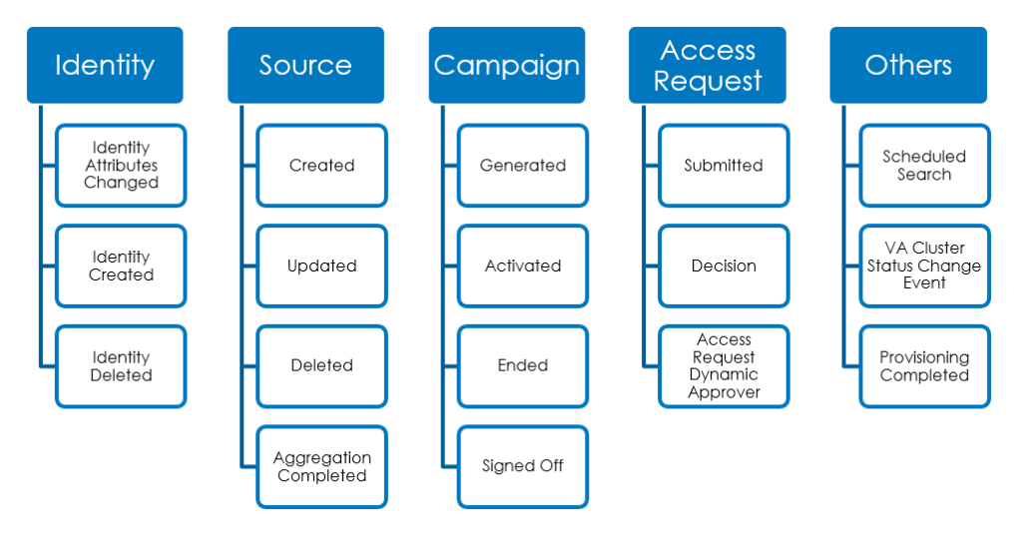
Event Triggers
e.g., target is to create a request in Snow when the user is terminated
Subscribe :
UI:
API:Triggers | SailPoint Developer Community
Filter:Without filtering, a subscribing service would be sent every single event that the trigger receives
Filtering: $[?($.identity.name == \"john.doe\")]“
Response modes: SYNC, ASYNC, and DYNAMIC. when the subscription type is set to HTTP
SYNC: should respond <10 mins, if not trigger invocation will terminate
ASYNC: Can respond anytime , but not less than subscription time
DYNAMIC: Sync for some, Async for some

Slide 14
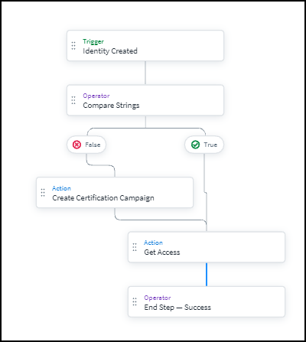
Workflows
A workflow is a set of steps that are completed every time a specific event occurs. Workflows do work for you, automatically performing a series of actions within your system that you can configure in response to a trigger.
enormous flexibility, allowing you to configure & automate most of processes
workflows are managed using JSON, but most parts of a workflow can be created and managed in the user interface.
e.g., Newjoiner onboarding, Snow integration & Provision initial password few target systems etc.
Data Flow Workflows start with a JSON input delivered by the trigger. As this input moves through the workflow, some steps will add additional JSON to it. This JSON that moves between steps is
Input Each workflow has an input in JSON format, provided by the trigger. This JSON data moves through each step in the workflow. When data enters a step, it becomes input.
Steps Each workflow is made of a set of discreet steps that are executed chronologically.
Triggers: determines when the workflow runs and provides the initial input used by the rest of the steps in the workflow. Each workflow must have exactly one trigger.
Actions: An action is any task a workflow performs outside of the workflow itself or change it makes to its JSON data. All workflows must have at least one action.
Operators: directing the data flow or making conditional choices

Slide 15
Workflows
{ "name": "WORKFLOW NAME", "description": "WORKFLOW DESCRIPTION", "version": "1.0", "definition": { "trigger": {}, "start":"", "steps": {} } }
Workflows are made of several parts:
The metadata, where you can define the workflow's name and description. If you use the visual builder to create your workflow, this is included automatically.
The trigger, which determines the event that causes the workflow to run.
The steps, called actions and operators, which define the actions and decisions a workflow makes as it runs.
Create Workflow:
Start with a Template allows you to choose a pre-configured set of steps and make changes to them based on the needs of your business.
Start in the Workflow Builder brings you to a canvas where you can drag and drop individual steps to create a brand-new workflow.
Start with a JSON File lets you upload a workflow in JSON format. You can reuse the JSON from another workflow using this option. In some cases, you can modify workflows created using this method in the workflow builder.

Slide 16
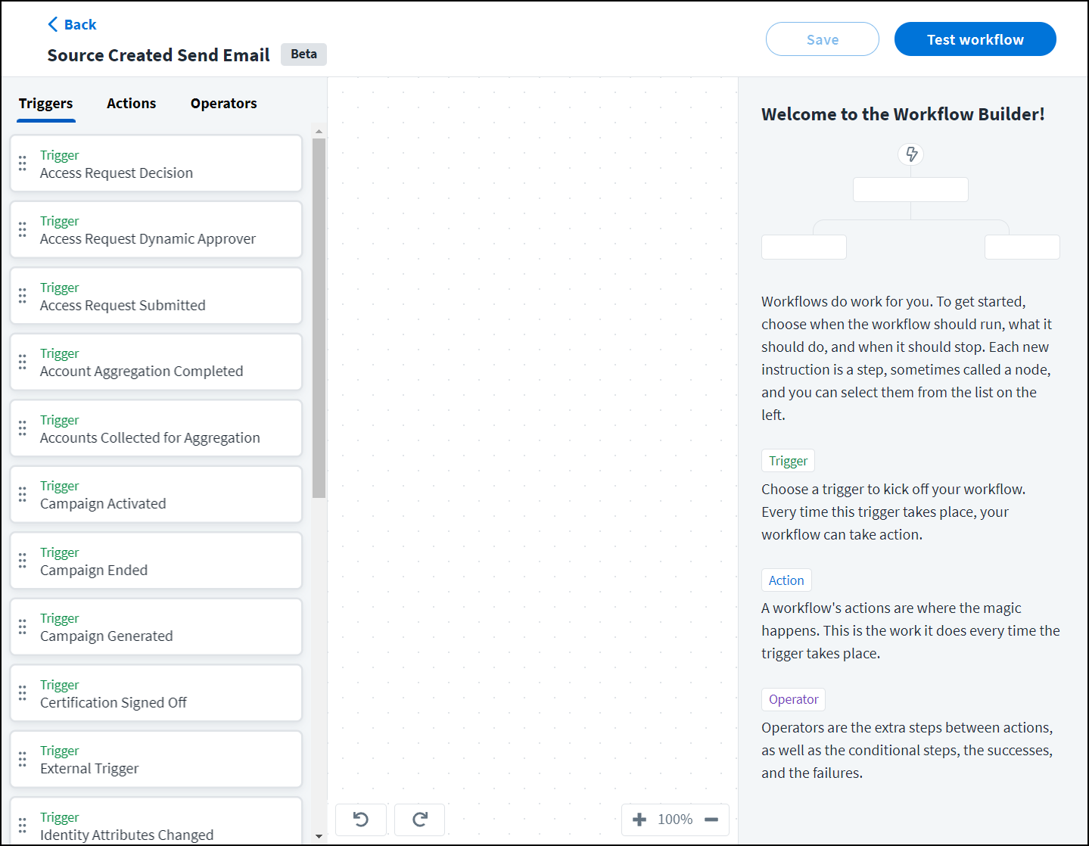
Workflows
Test a workflow:
Select the workflow you want to test from the list of workflows and select Edit Workflow.
Select Test Workflow at the top of the editor.
The Test Workflow overlay is displayed.
Operators:
Operators allow you to choose the path your workflow should take. Use choice operators to compare two items or use a loop to perform a set of actions on every item in a list. Operators also include the end steps, used to mark the end of a workflow.
Operators - SailPoint Identity Services
Actions:
Each workflow action receives input from the data flow and performs an action in your system. The values you enter in the fields for each action help determine what is done and how. The result of each action, in JSON format, is added to the workflow's data flow.
Actions - SailPoint Identity Services

Slide 17
API
Identity Security Cloud API
APIs provide developers with a way to interact with the ISC platform and extend it. Developers can leverage these APIs to customize their platform experiences and build new solutions and integrations
PAT: https://{tenant}.identitynow.com/ui/d/user-preferences/personal-access-tokens
A personal access token (PAT) is a method of authenticating to an API as a user without providing a username and password.
PATs are primarily used in scripts or programs, two components that comprise the token: the Client ID and the Client Secret.
Authorization :
Client Credentials
Authorization Code
Refresh Token
erved.

Slide 18
API
Scopes
Scopes are granular permissions you can add to personal access tokens (PATs) to create tokens with the least privilege necessary to fulfill their functions.
sp:scopes:default: default scope
sp:scopes:all: access to all scopes
V3 APIs: standard
Beta APIs: are subjected to change
https://api.identitynow.ocm/api/v3/makes/phone
https://
<hostname> : api.identitynow.com
<basepath> : api/v3
<Collection> : makes
<resource> : Phone
erved.

Slide 19
API
Token URL: https://tenant.api.identitynow.com/oauth/token
Authorization URL: https://tenant.login.sailpoint.com/oauth/authorize
Oauth Info URL: https://{tenant}.api.identitynow.com/oauth/info
"authorizeEndpoint": "https://iga-sb.login.sailpoint.com/oauth/authorize",
"tokenEndpoint": "https://iga-sb.api.identitynow.com/oauth/token",
curl -L -X GET 'https://sailpoint.api.identitynow.com/v3/access-profiles' \
-H 'Accept: application/json' \
-H 'Authorization: Bearer <TOKEN>'
erved.

Slide 20
API
Identity Security Cloud API
limit
offset
count
GET /v3/public-identities?limit=2
GET /v3/public-identities?limit=20&offset=4
GET /v3/public-identities?count=true
POST https://{tenant}.api.identitynow.com/v3/search?limit=100&count=true
{
"indices": ["identities"],
"query": {
"query": "*"
},
"sort": ["id"],
"searchAfter": ["2c9180835d38ca0c015d606b50851b1e"]
}
/v3/public-identities?limit=20&filters=firstname eq "john"&sorters=-name

Slide 21
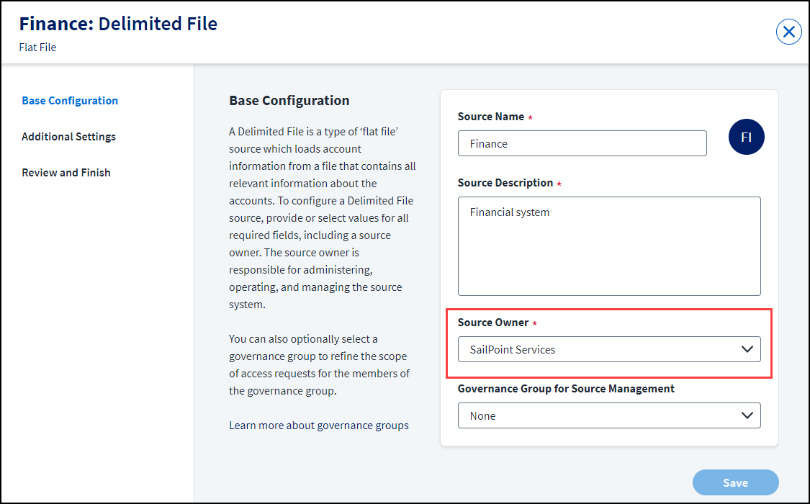
Managing Sources
Event: A source is the Identity Security Cloud representation of a third-party application, database, or directory management system that maintains its own set of user accounts or personnel records
https://documentation.sailpoint.com/connectors/identitynow/landingpages/help/landingpages/identitynow_connectivity_landing.html
Source type -
Connection type - The method used to add the source to Identity Security Cloud.
Source Owner - The owner of the source. After you've configured a source, you can assign a source owner.
Governance Group - The group used for granting users source role sub-admin level oversight of the source and its access.
Additional connectivity details:

Slide 22
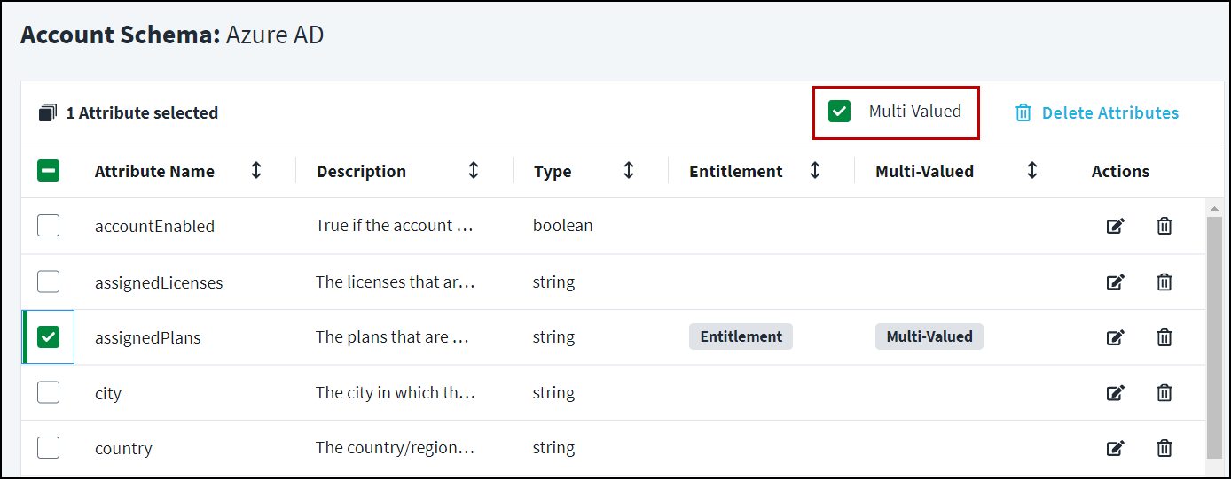
Managing Sources
Path: Admin > Connections > Sources.
Go to Admin > Connections > Sources.
Select the source you want to edit.
Go to Import Data > Account Schema.
Go to Admin > Connections > Sources.
Select the source you want to update.
Go to Import Data > Correlation.
Native Change Account Created events are fired for sources configured to monitor Account Creations.
Native Change Account Updated events are fired for sources configured to monitor Account Updates.
Native Change Account Deleted events are fired for sources configured to monitor Account Deletions.

Slide 23
ITSM ServiceNow Integration
IdentityNow's Service Integration Module, or SIM integration with ServiceNow, which converts IdentityNow provisioning actions into tickets in ServiceNow.
e.g., new joiner requires laptop where request initiated from IdentityNow, but ticket gets created in ServiceNow
Pre-requisites:
At least one disconnected source for manual task
ServiceNow instance(Generating/Managing tickets)
Authentication(basic/Oauth)
Install Updated sets from compass(XML files) & configure snow
reference client specific needs, Sample CatLog items etc.
Integration Types:
Identity Governance Connector
Service Desk
Service Catalogue for IdentityNow
Queued/Failed/Committed/Retry
provisioningStatusCheckIntervalMinutes (~15 mins)
provisioningMaxStatusCheckDays Max days(1-90 days)

Slide 24
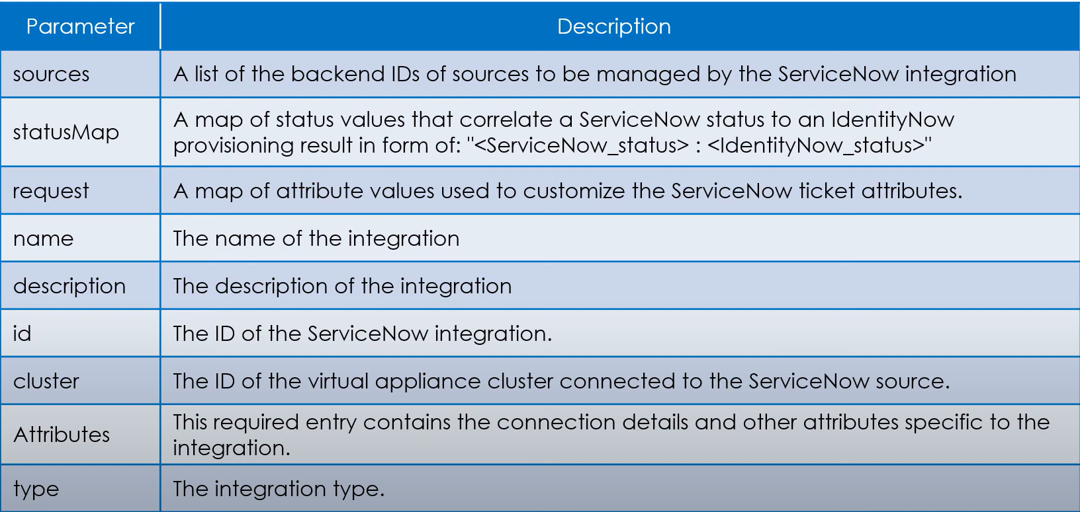
ITSM ServiceNow Integration
$orgName = 'yourIdentityNowOrgName' $integrationBaseURI = "https://$($orgName).api.identitynow.com/cc/api/integration" $listIntegrations = Invoke-RestMethod -Method GET -Uri "$($integrationBaseURI)/listSimIntegrations" -Headers @{Authorization = "$($v3Token.token_type) $($v3Token.access_token)"}
/integration/createSimIntegration API
"statusMap": {
"closed_cancelled": "Failed",
"closed_complete": "Committed",
"closed_incomplete": "Committed",
"closed_rejected": "Committed",
"in_process": "Queued",
"requested": "Queued"
},

Slide 25
Email Templates
Many system activities send emails to notify users of process milestones and tasks assigned to them
Fixed Input/Output arguments & global variables
${user.workPhone}
By default, all enabled, can be disabled through process configurations or subject prefix as #stop #no_send #Stop
Global Variables Version 1 : user, identityNowUrl, spTools ($spTools.formatDate($certification.expiration, "MM/dd/yyyy HH:mm")
Version 2: getUser(), getObjectByJsonPath()
Available Email Templates - SailPoint Identity Services
erved.

Slide 26
Glossary
VA: Linux-based virtual machine that connects to your sources and apps using SailPoint APIs, connectors, and integrations.
SOD: A feature that allows admins to maintain control the checks and balances of access that keep an organization safe.
PAT: A set of user credentials that an API client can use to connect to SailPoint’s APIs.
Identity Profile: Instructions for creating and managing identities from the associated authoritative source or sources.
© Hitachi Vantara LLC 2022. All hts Res

Slide 27
For Any Queries:
Documentation : Identity Security Cloud
IdentityNow: IdentityNow
Connectors: Connectros Available
For any support IAM Delivery & IAM Operations Team, you can reach out to below persons.
Aman Verma 1 Nikhil Shrirao
IAM Team

